Slide 1

EMPLOYEE ATTRITION IN HEALTHCARE INDUSTRY
Group 5
Quynh Truong
Tai Phan
Tung Tran
Trung Dang

Slide 2


Agenda
Introduction and data checking
Clean data
Data visualization​

Slide 3

Introduction

Slide 4
Data set Introduction
Employee attrition happens when the size of workforce diminishes over time, through any method, including voluntary resignations, layoffs, failure to return from a leave of absence, or even illness or death.
Whenever anyone ceases working for the company for any reason and is not replaced for a long time (if ever), that would be employee attrition. This means that employees are leaving faster than they are hired.
Challenges that an organization has to face due employee attrition are:
Expensive in terms of both money and time to train new employees.
Loss of experienced employees
Impact in productivity Impact profit
Employee attrition can happen for several reasons includuding:
unhappiness about benefits or the pay structure,
a lack of development opportunities,
and even poor conditions in the workplace.
Source: Employee Attrition for Healthcare | Kaggle

Slide 5
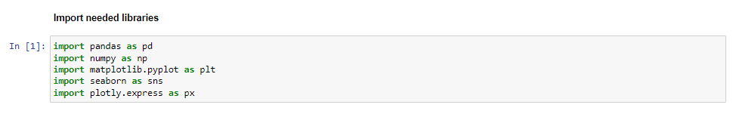
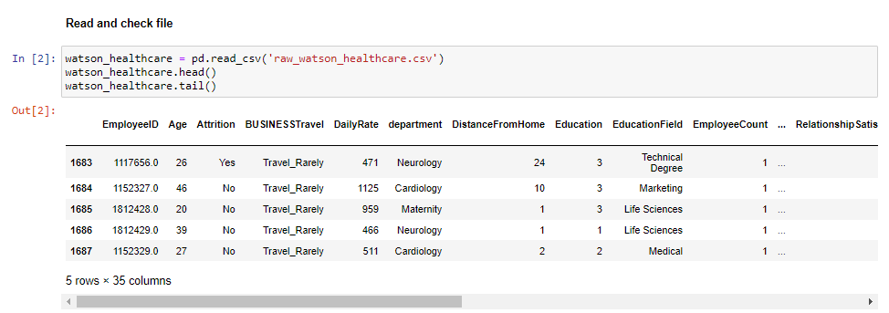
Import library and check

Slide 6

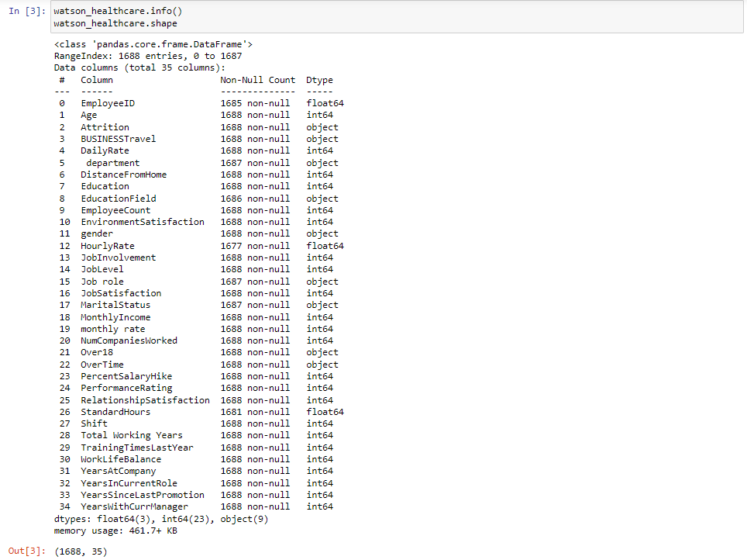
Overview

Slide 7
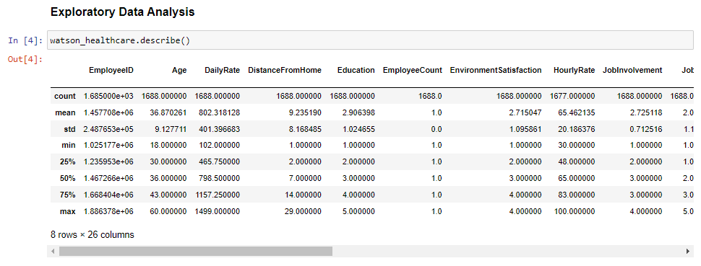
Exploratory Data Analysis

Slide 8
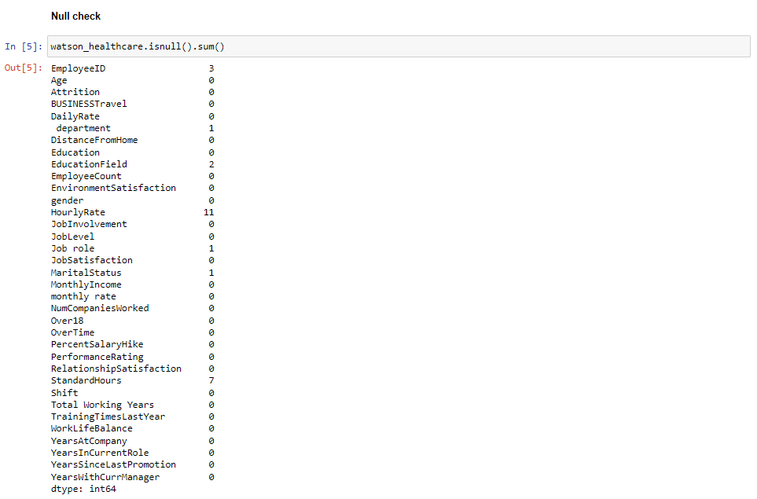
Null Check

Slide 9
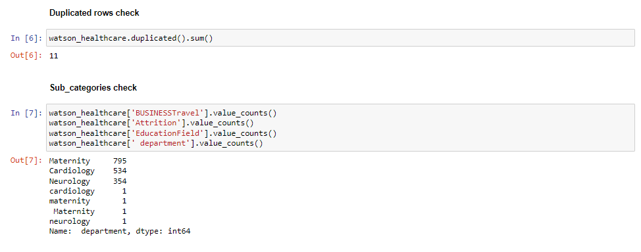
Duplicate And Subcategories Check

Slide 10

CLEANING DATA

Slide 11
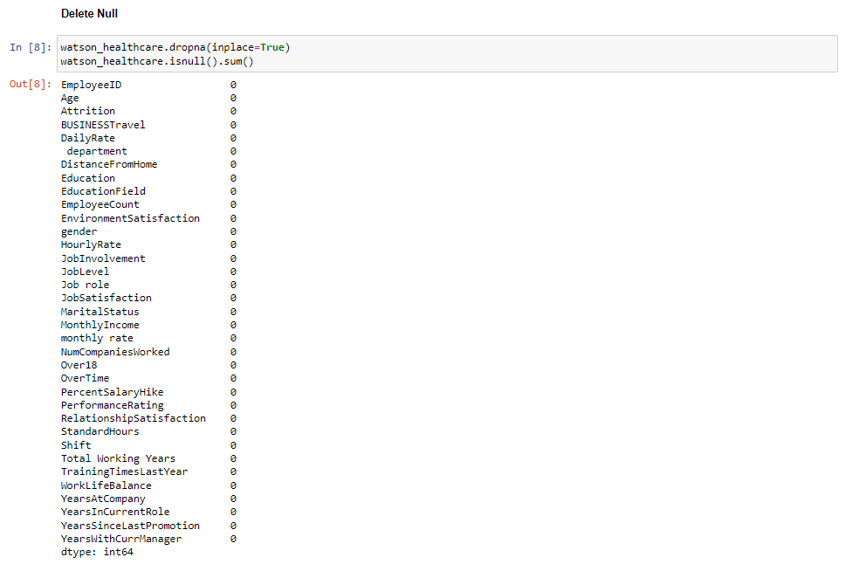
Delete Null

Slide 12
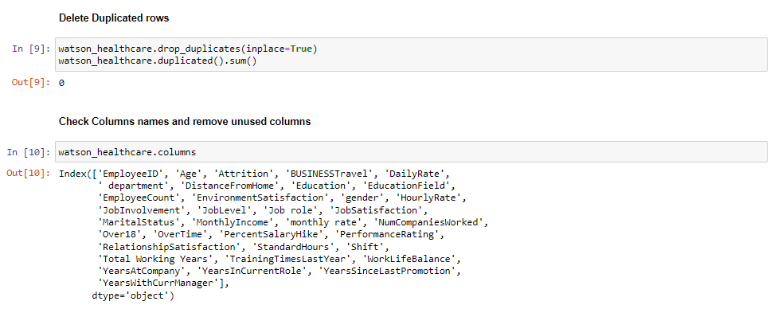
Delete Duplicate and Remove Unused Col

Slide 13
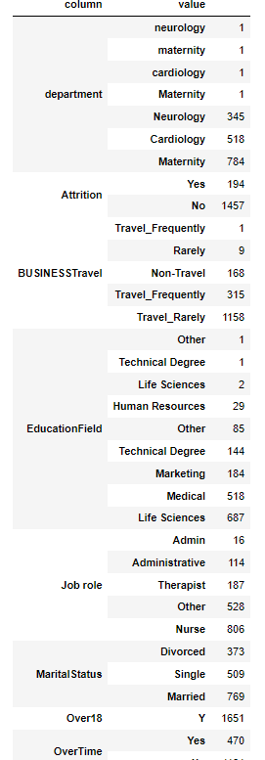
Remove Column
We are going to delete columns by some reasons
Column EmployeeID has no contribution to this analysis.
Column Over18 have its values are Yes at all rows.
Column EmployeeCount have all value 1 in its rows.
Column StandardHour have all same value 80 in its rows.

Slide 14
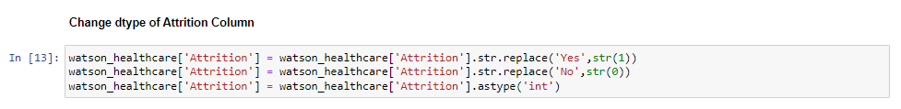
Change Dtype Of Attrition Column
Need 'int' type of Attrition for making correlation check with others

Slide 15
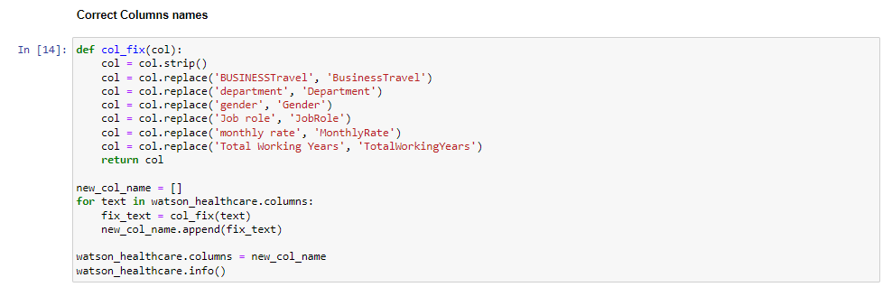
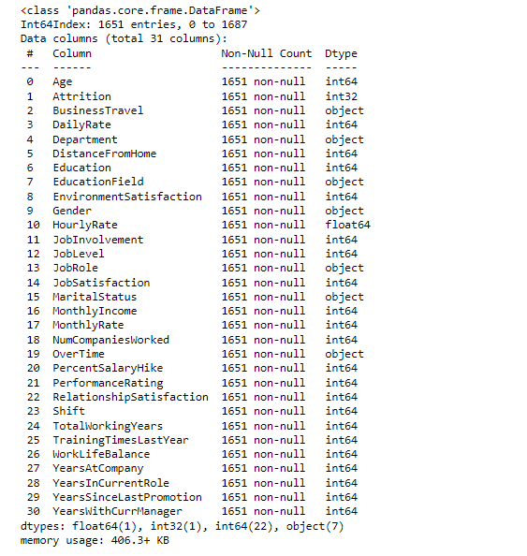
Column Name Correction

Slide 16
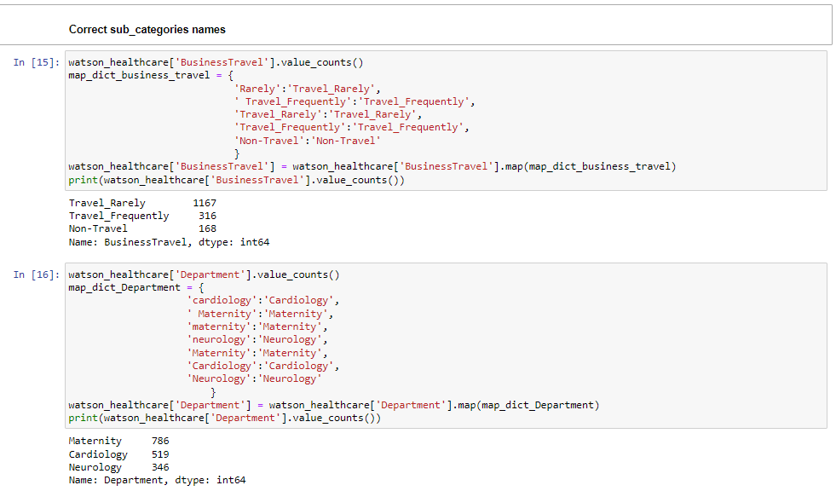
Correct Sub-categories Names

Slide 17
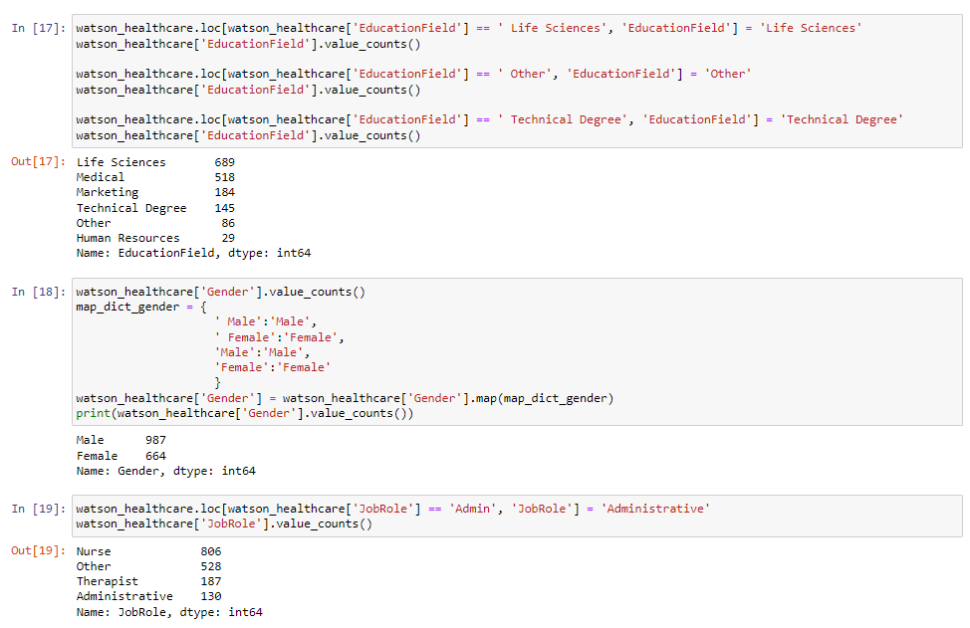
Correct Sub-categories Names

Slide 18
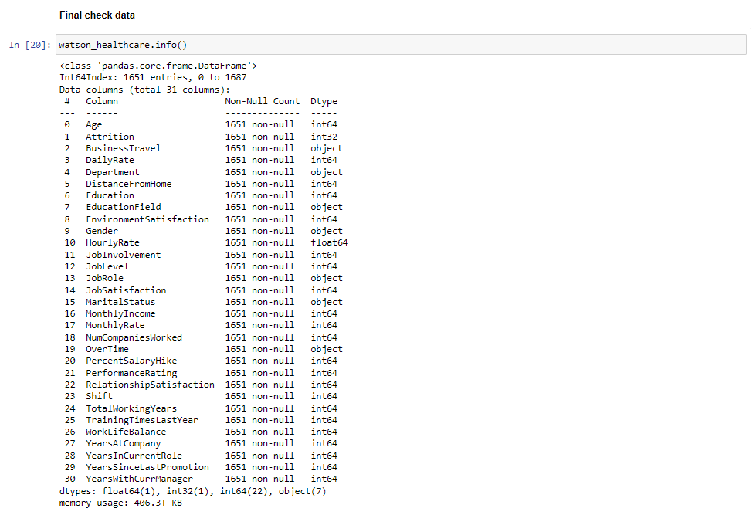
Final Check Data

Slide 19

Data visualization

Slide 20
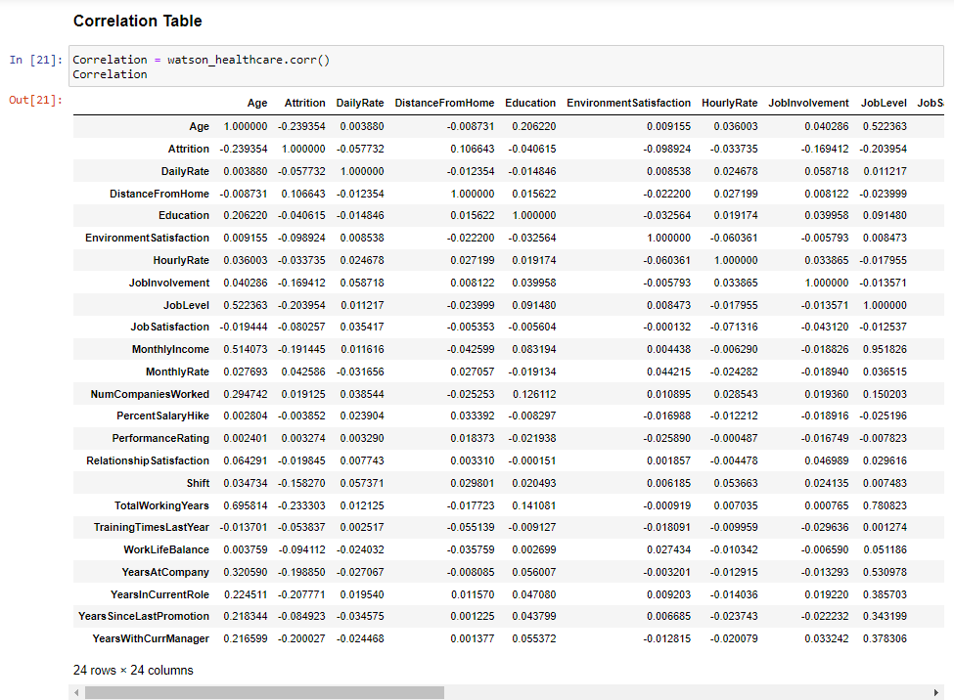
Correlation Heatmap
Due to many but low correlation ratios as statistics above, We should consider some correlation from 0.5.
Below that point should be dropped out the analysis

Slide 21
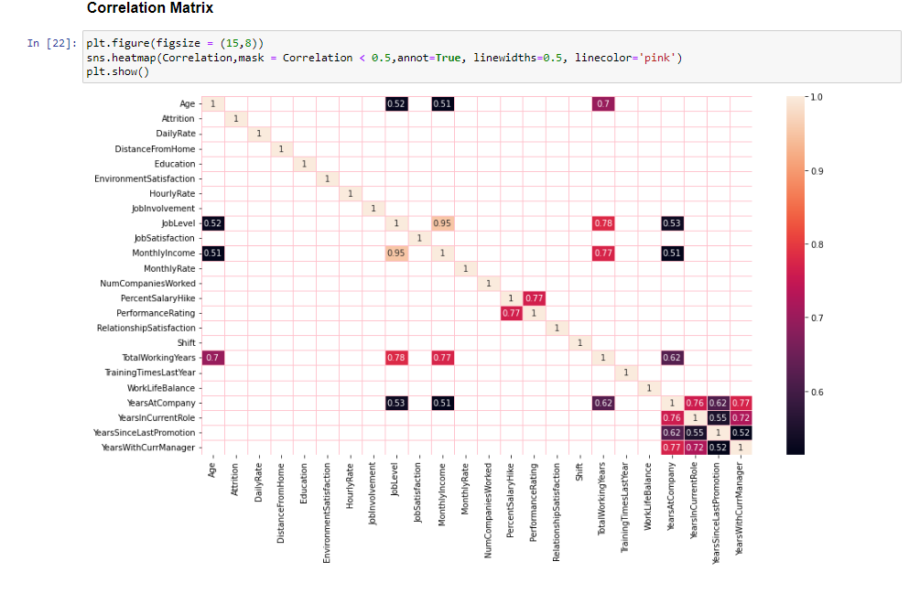
Correlation Matrix

Slide 22
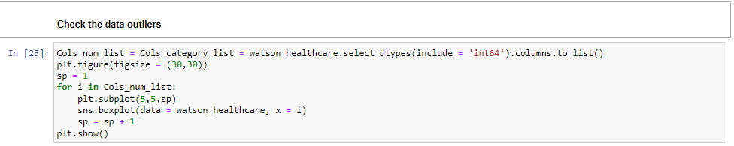
Check the data outliers

Slide 23
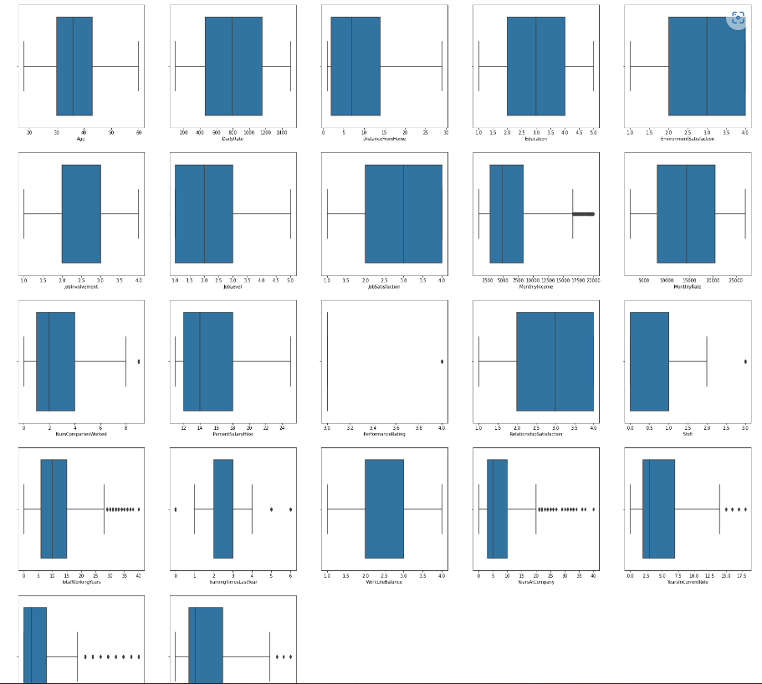
Check the data outliers
We can see there are no missing data, and
Some variables have outliers but it is not far from the half of data.

Slide 24
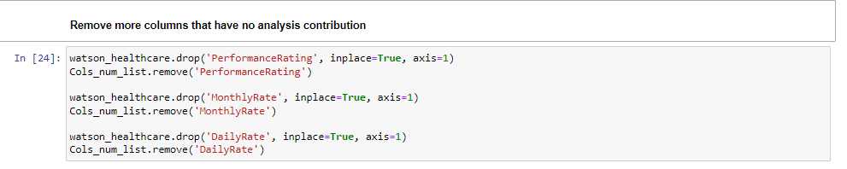
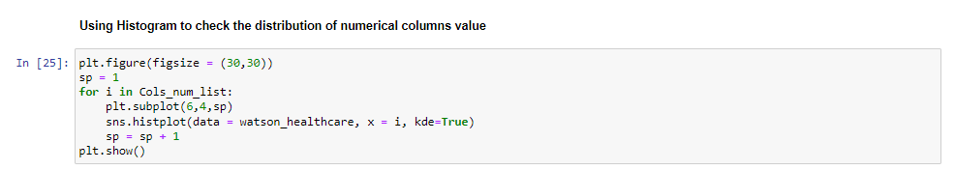
Remove More Columns That Have No Analysis Contribution

Slide 25
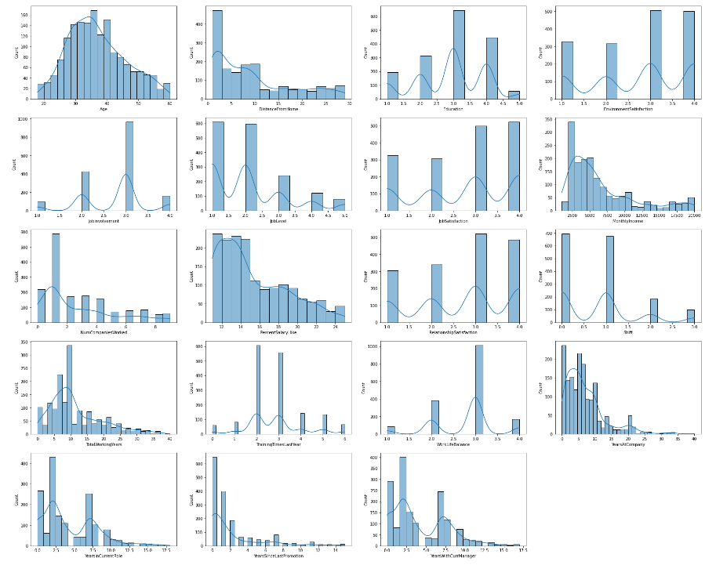
Using Histogram
To Check The Distribution Of Numerical Columns Value

Slide 26
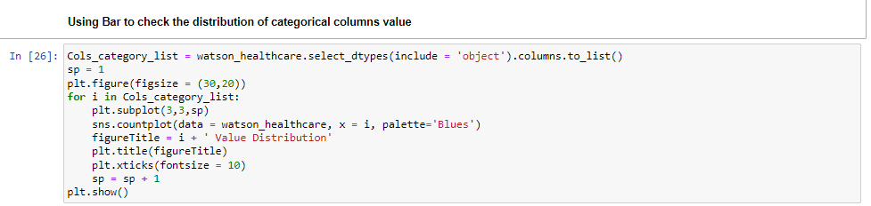
Using Bar Graph

Slide 27
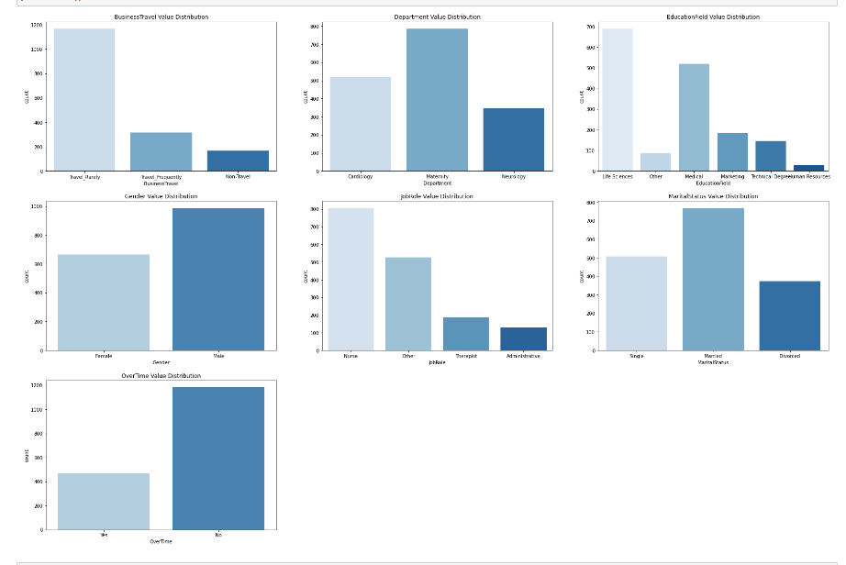
Using Bar Graph

Slide 28
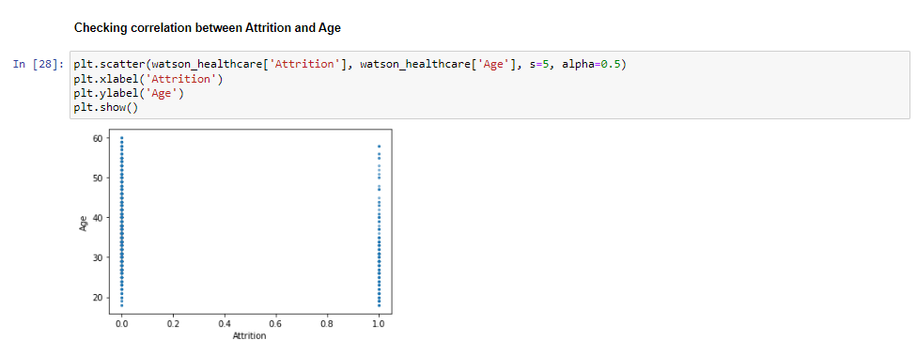
Correlation Between Attrition And Age
We could see there is no correlation between the two variables.
Therefore, we use another way to see the Attrition happened in each other variables by which spectrums

Slide 29
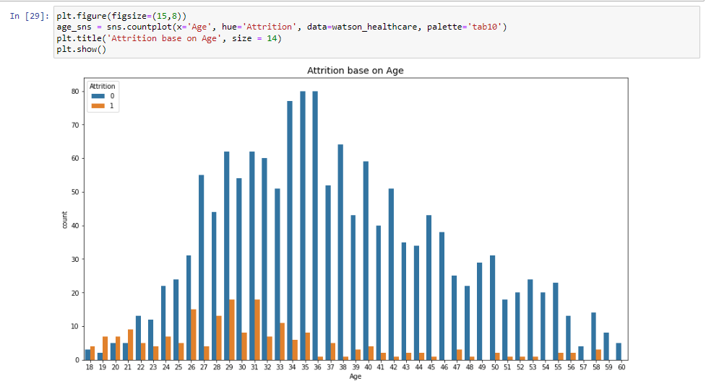
Attrition By Age
We can see there is high attrition possibility in employees who are at the age of 26 to 33

Slide 30
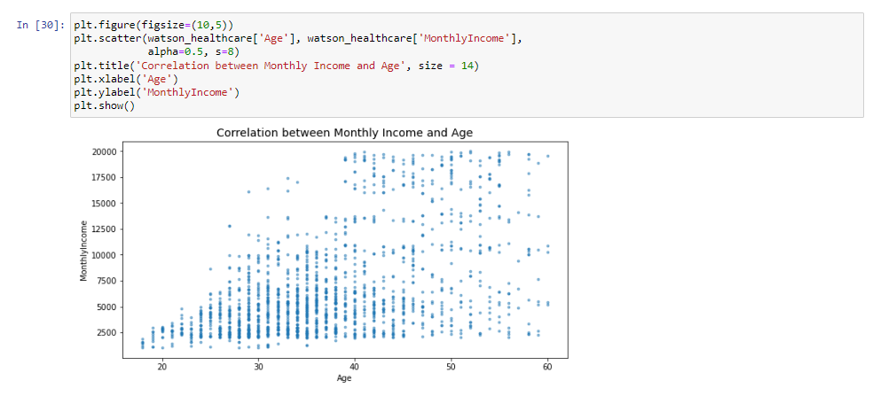
Age And Monthly Income
There is a moderate correlation between Age and Monthly Income, the older age the employees are the more income they have.

Slide 31
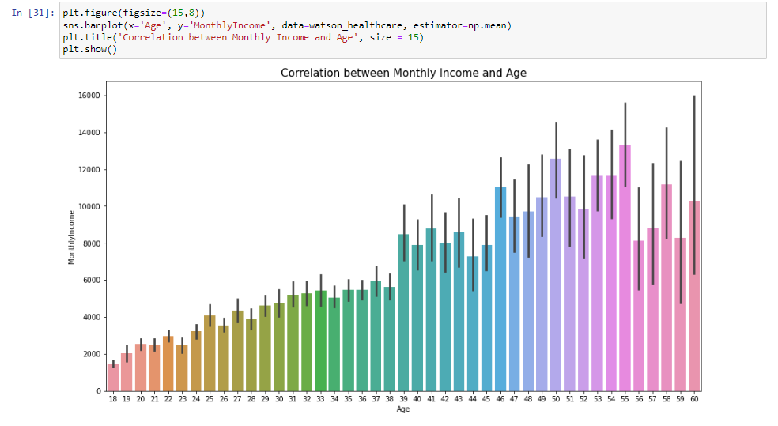
Monthly Income and Age
We already know that Attrition happened almost in group of employees's age from 26 to 33, in other way we could say that with Monthly Income from 3800𝑏𝑒𝑙𝑜𝑤 5000 are likely at high attrition possibility.

Slide 32
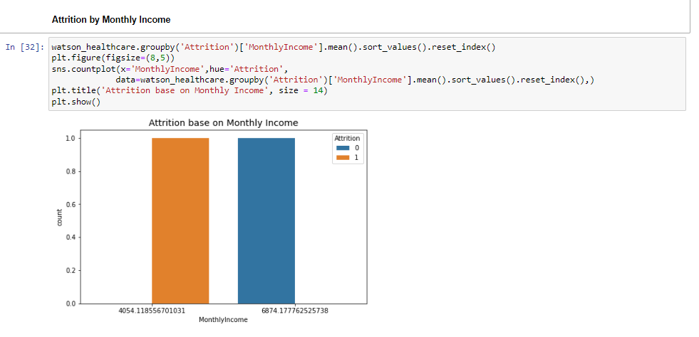
Attrition by Monthly Income
The average income which is at the high attrition is $4050 per month.

Slide 33
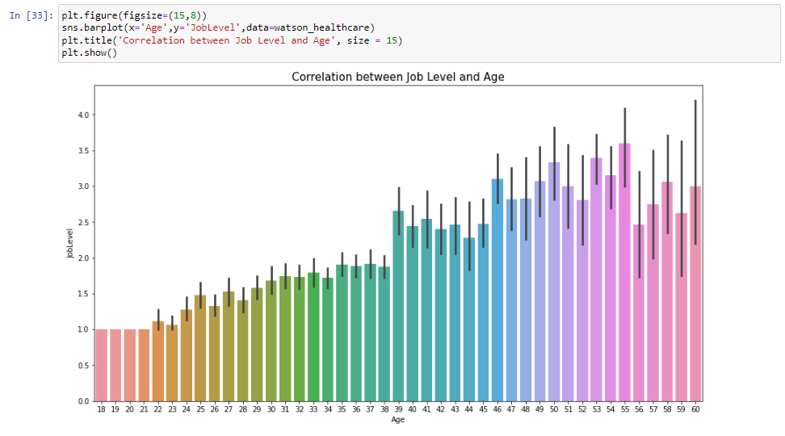
Correlation between Job Level and Age

Slide 34
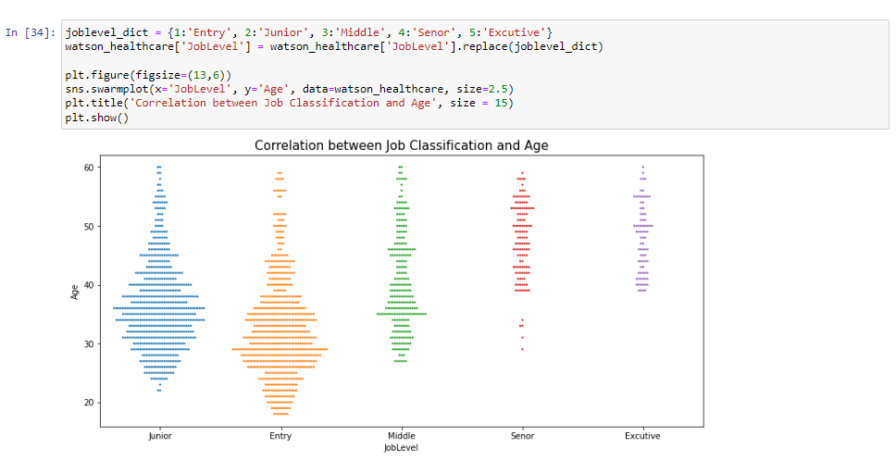
JobLevel Classification
The age of high attrition is from 26 to 33, with the Job Qualification as 'Entry' and 'Junior'.

Slide 35
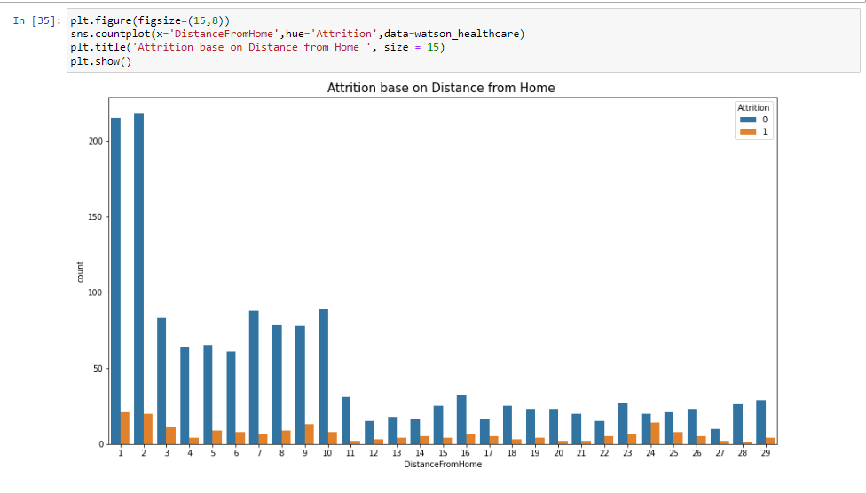
Distance From Home
Based on 'Distance from home' factor, we could not draw any connection or could not say that the attrition was affected by Distance from home.
There are possibly attritions at any distance of employee's locations and their workplaces

Slide 36
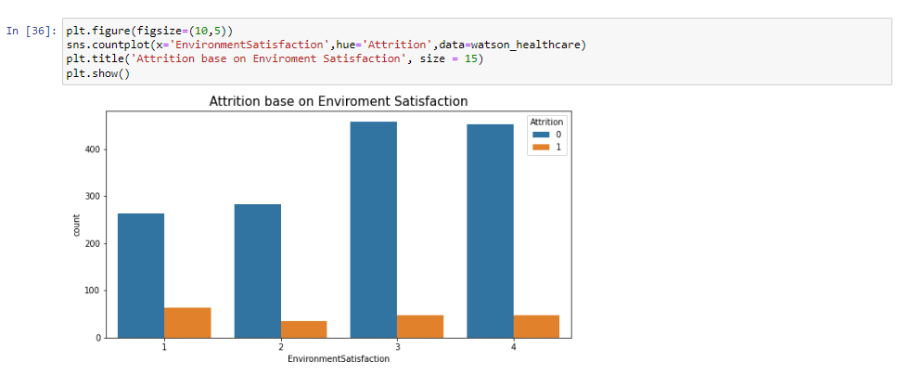
Environment Satisfaction
We could see the high rate of Environment Satisfaction the less portion of attrited employees in total

Slide 37
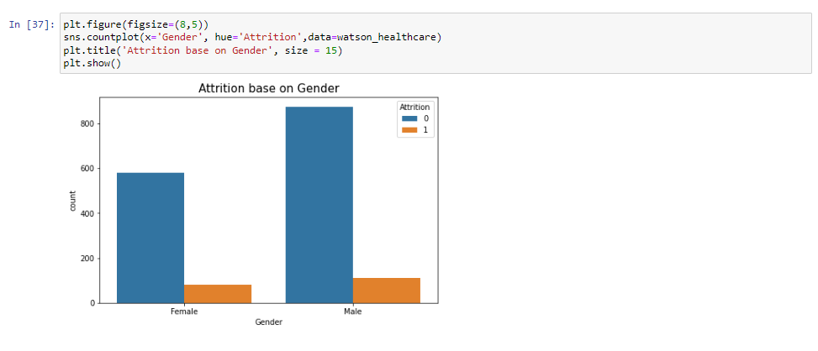
Gender
The number of male employees who are attrited person bigger than female counterpart

Slide 38
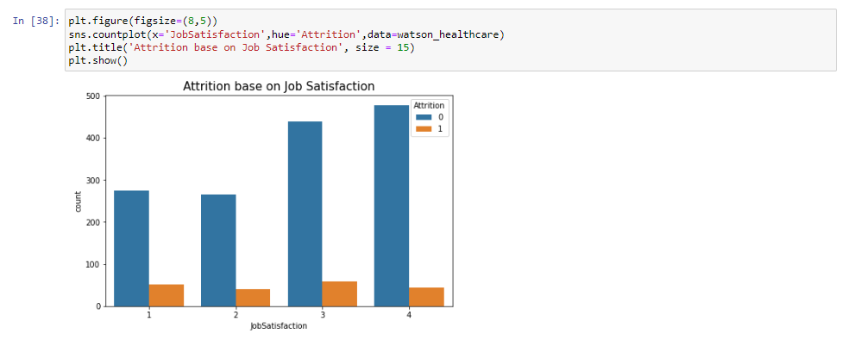
Job Satisfaction
Same as Environment Satisfaction trend, high rate of Job Satisfaction also led to less portion of attrited employees in total

Slide 39
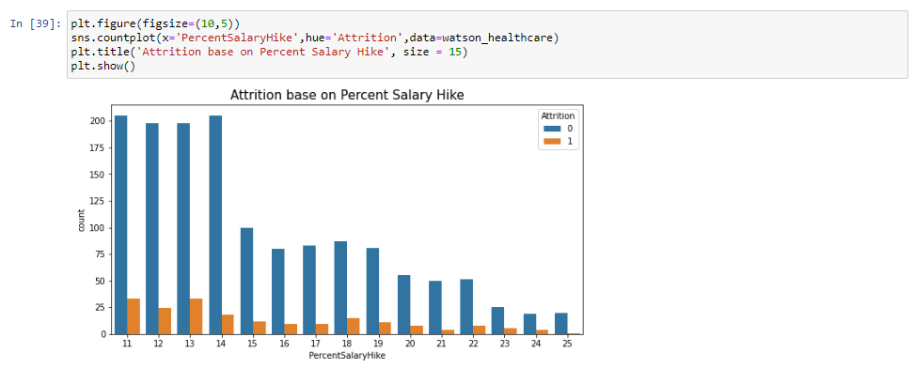
Percent Salary Hike
People who have little increasing which less than 14% compared to their previous yearly salary are also tend to quit job.

Slide 40
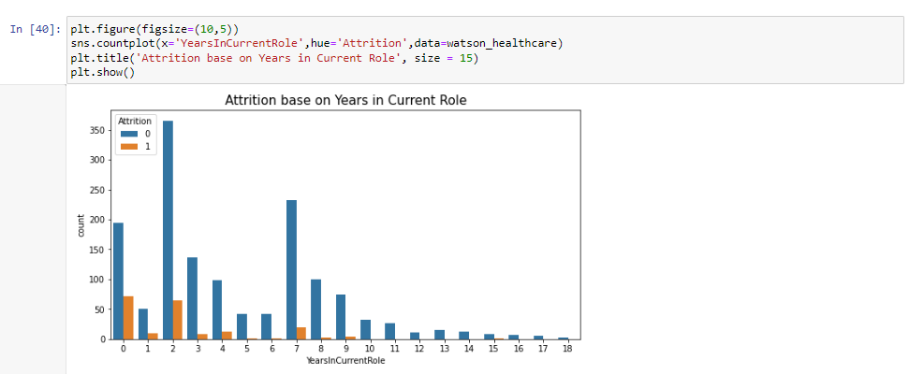
Current Role

Slide 41
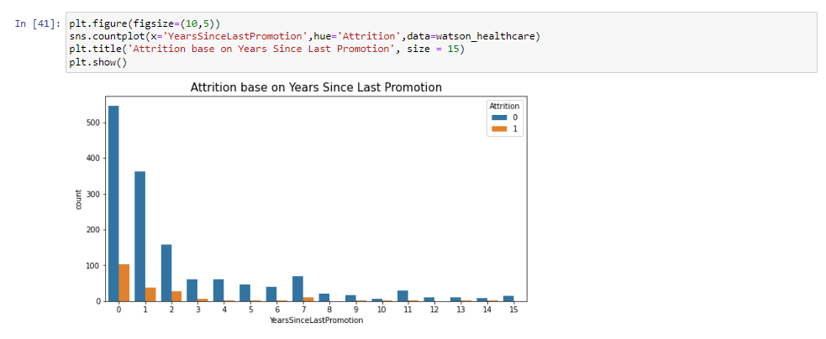
Years Since Last Promotion
Not surprisingly, many attrited employees who have 0 year since Last promotion which mean they haven't been promoted before the quit

Slide 42
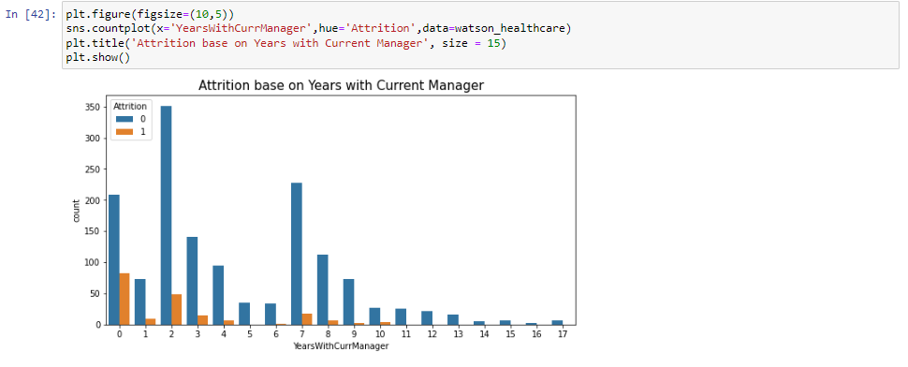
Years With Current Manager
Attrited Employees also have very short period of working with current manager, its range from 0 to 2 years

Slide 43
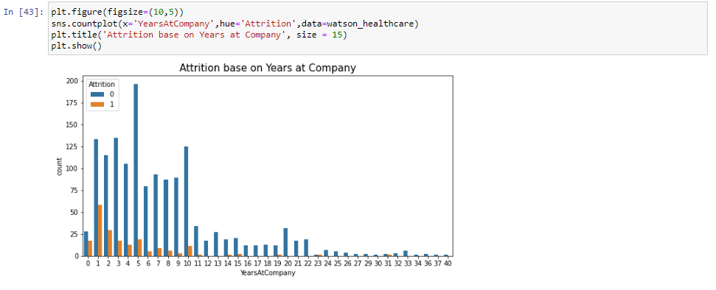
Years At The Company
Years at the company which less than 2 years is also the characteristic of attrited employees

Slide 44
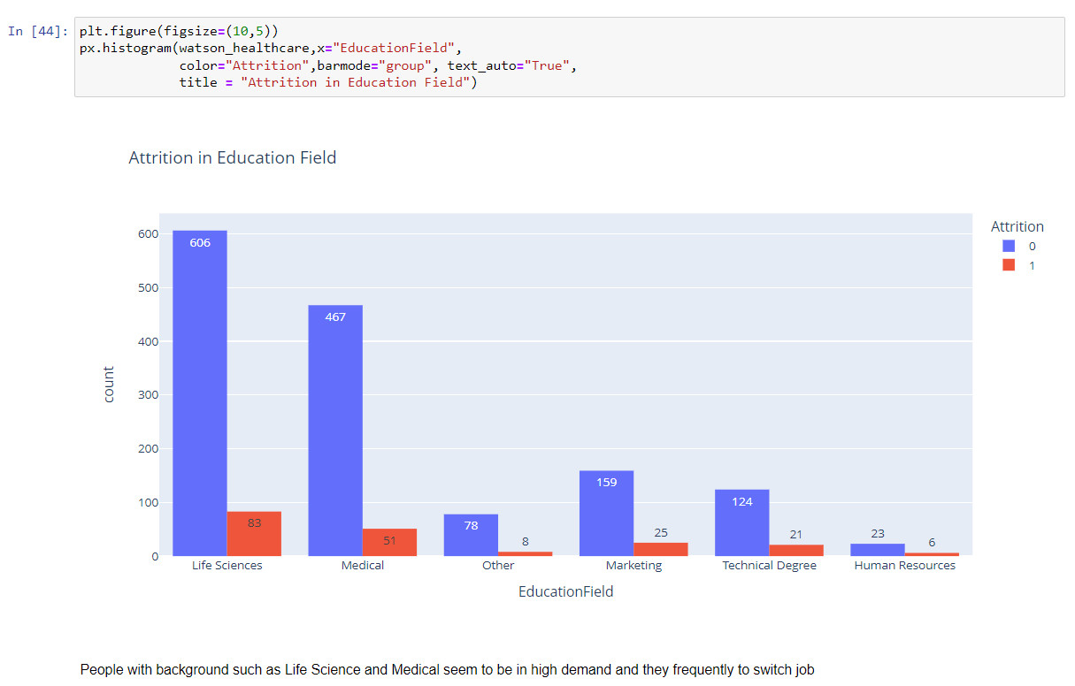
Education Field
People with background such as Life Science and Medial seems to be in high demand and they frequently switch jobs

Slide 45
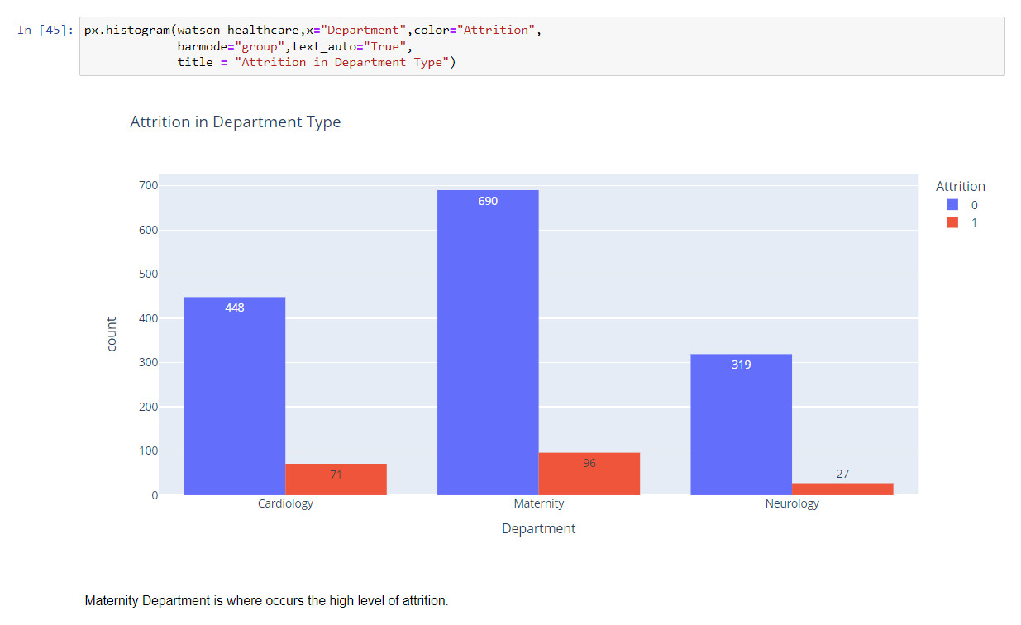
Department Type
Maternity Department is where occurs the high level of attrition

Slide 46
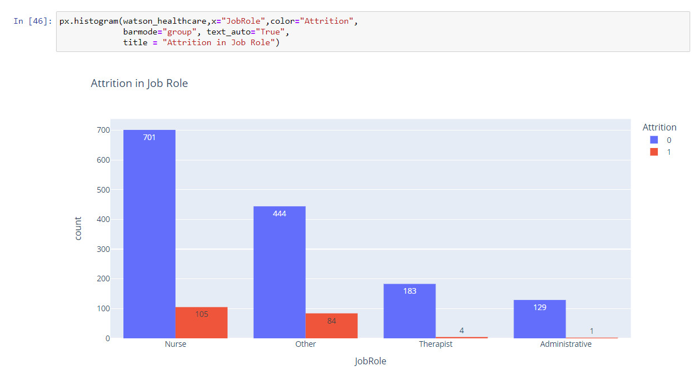
Job Role
There are a significant number of attrited staff from Nurse and other roles. In the other side, Therapist and Administrative role are unlikely to quit

Slide 47
Conclusion
We can see from the historical data and could predict about the Attrition based on the below indicators
Age: 26 to 32
Monthly Income: 3800 - 4200 (with 4050 mean)
Job Level: Junior
Job Satisfaction: Low
Environment Satisfaction : Low
Percent Salary Hike: Low, < 15%
Since Last Promotion: 0 year
Years In Current Role: 0-2 years
Years At Company : 0-2 years
Background: Medical, Life Science
Department: Maternity, Cardiology
Role: Nurse
An employee who get as many as from these signs is likely at high possibility of attrition

Slide 48


Thank you

